Slide 1
Advanced Traffic Management: Review 2
BY:
Sumeet Omalur(RA1611008010384)
Sarthak Gupta(RA1611008010368)
Swasti Sumedha Tewari(RA1611008010686)
Tanya Mishra(RA1611008010526)

Slide 2
Methodology
The dataset that is used in this project contains the count start date of the traffic count along with the daily count of vehicles on roads as well as a 5-day ADT (Monday-Friday) and a 7-day ADT (Monday-Sunday) value. It also contains the AM/PM hour timings along with the percentage of different types of vehicles.
To ensure a smooth and accurate analysis we will be taking a monthly analysis of the 7-Day-ADT by consolidating the various 7-Day ADT Values and averaging it to get a single value for a particular month.
Libraries such as numpy, pandas and scikit-learn are used to process and clean the data such as missing values and other inconsistencies

Slide 3
Algorithms Used
The algorithms that are used are given as follows:
Linear Regression: It is a supervised machine learning algorithm that is based on the equation Ax+B where A is the coefficient of x and B is the intercept of the the equation. It uses the concept of regression which models the target prediction value based on the trend of previous target values.
ARIMA: Auto Regressive Integrated Moving Average Models or ARIMA is a forecasting technique that predicts future values of a series based on parameters for a series with a small number of points to ensure that there are minimum outliers in the prediction.

Slide 4
Literature Survey
The following slides contain the journals that were studied and the inferences that were made from them.

Slide 5
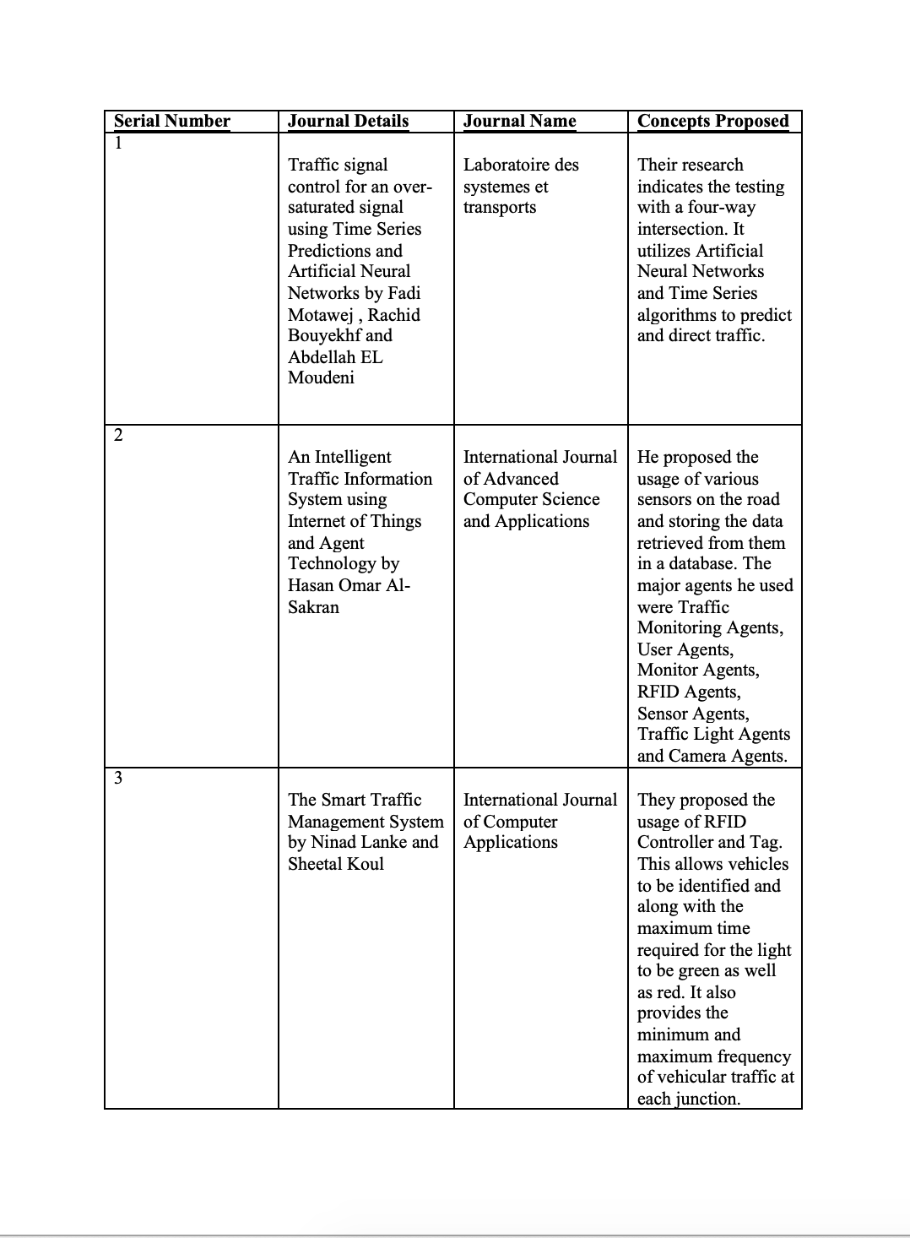

Slide 6
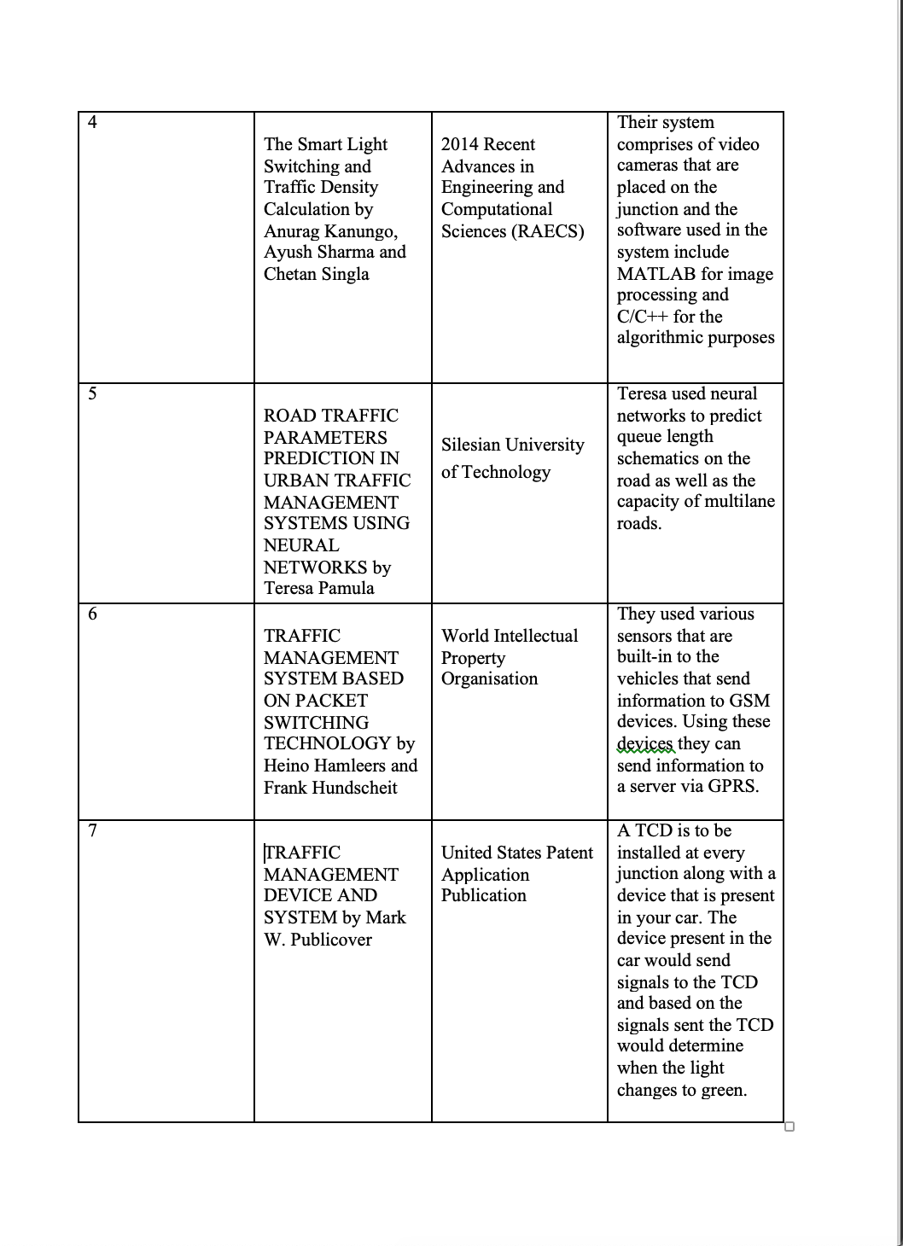

Slide 7
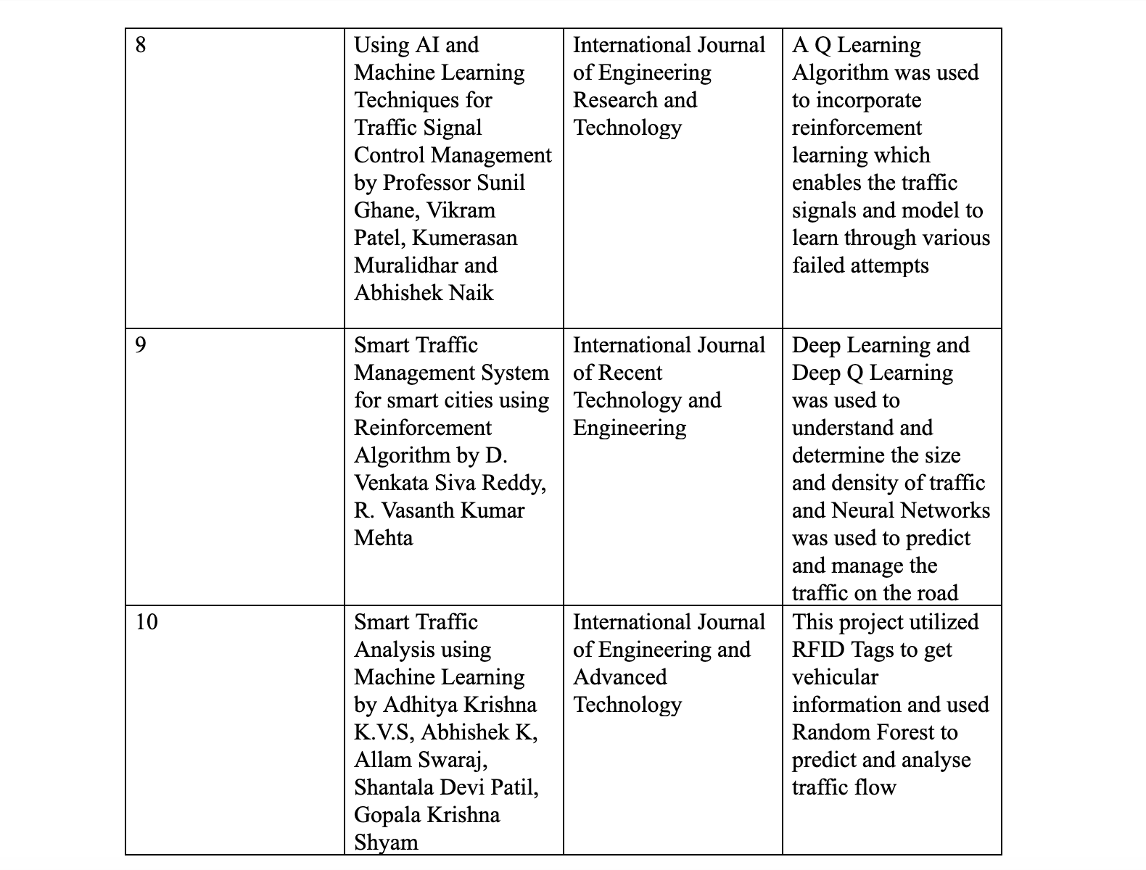

Slide 8
Inferences
From the above research papers we can infer the following:
Instruments such as Monitors, Cameras, RFID Sensors and Traffic Light Sensors were used to collect data from traffic signals and junctions
GSM Devices were used to transmit the result of the analysis to the users and authorized parties.
Algorithms and Technologies such as Neural Networks, Time Series, MATLAB, C/C++, Python, Anaconda were used to predict traffic flow.
The Projects were mainly hardware dependent an depended on their efficiency.

